Slide 2
Absence of Copyright
This slideshow contains photos, diagrams, and information, some of which were attained through internet searches of public websites. The author of this presentation does not own the copyright on this information, so this slideshow is for personal use only—not for sale or profit. Please utilize it to seek the Lord and grow in your knowledge of His Word and ways.

Slide 4
END HERE JULY 1, 2020
WEEK 8
BEGIN HERE JULY 9, 2020

Slide 5
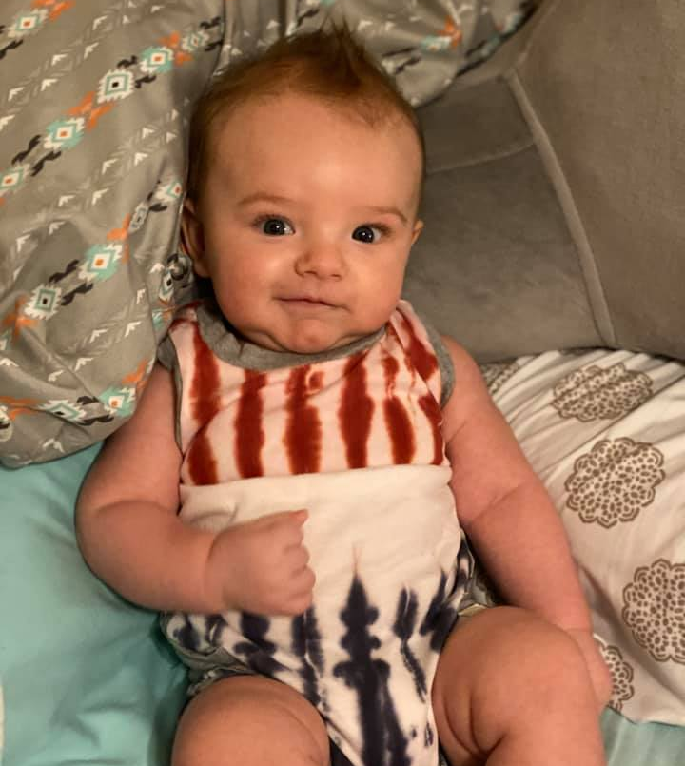
Happy Independence Day from my grandson Noah!

Slide 6
Prayer and Announcements
Sunday: 9:15 Fellowship
9:30 SS Master Class
10:30 Worship
Revelation Study available on our church website
www.faithprinceton.org
Email questions and comments to
pastor@faithprinceton.org

Slide 8
Revelation 4 – A Glimpse into Heaven
Beginning in verse 5...

Slide 9
Revelation 4:1-4
1 After these things I looked, and behold, a door standing open in heaven, and the first voice which I had heard, like the sound of a trumpet speaking with me, said, “Come up here, and I will show you what must take place after these things.” 2 Immediately I was in the Spirit; and behold, a throne was standing in heaven, and One sitting on the throne. 3 And He who was sitting was like a jasper stone and a sardius in appearance; and there was a rainbow around the throne, like an emerald in appearance. 4 Around the throne were twenty-four thrones; and upon the thrones I saw twenty-four elders sitting, clothed in white garments, and golden crowns on their heads.
Notes:
Last week!

Slide 10
Revelation 4:5-7
5 Out from the throne come flashes of lightning and sounds and peals of thunder. And there were seven lamps of fire burning before the throne, which are the seven Spirits of God; 6 and before the throne there was something like a sea of glass, like crystal; and in the center and around the throne, four living creatures full of eyes in front and behind. 7 The first creature was like a lion, and the second creature like a calf, and the third creature had a face like that of a man, and the fourth creature was like a flying eagle.

Slide 11
Revelation 4:8
8 And the four living creatures, each one of them having six wings, are full of eyes around and within; and day and night they do not cease to say,
“Holy, holy, holy is the Lord God, the Almighty, who was and who is and who is to come.”

Slide 12
Revelation 4:9-11
9 And when the living creatures give glory and honor and thanks to Him who sits on the throne, to Him who lives forever and ever, 10 the twenty-four elders will fall down before Him who sits on the throne, and will worship Him who lives forever and ever, and will cast their crowns before the throne, saying,
11 “Worthy are You, our Lord and our God, to receive glory and honor and power; for You created all things, and because of Your will they existed, and were created.”

Slide 13
Revelation 4 – A Glimpse into Heaven
Last week vs 1-4
This week begin with verse 5

Slide 14
Revelation 4:5-6
5 Out from the throne come flashes of lightning and sounds and peals of thunder. And there were seven lamps of fire burning before the throne, which are the seven Spirits of God; 6 and before the throne there was something like a sea of glass, like crystal; and in the center and around the throne, four living creatures full of eyes in front and behind.
Reminiscent of Sinai (Exodus 19:16) = lightning, thunder, fire
“sevenfold Spirit of God” (NLT) = Rev. 3:1; 4:5; 5:6
Notes:
Morris, Tyndale
Vs 5
Seven spirits recurs in 3:1; 4:5; 5:6. On the whole it seems most probable that we should see seven as signifying perfection or the like, and the whole expression as pointing to the Holy Spirit. The number may derive from Isaiah 11:2–3, and be meant to remind us of the seven modes of operation of the Spirit.
Pulpit Commentary: The Holy Spirit, represented in his sevenfold operation, by lamps, which illumine. The same idea is expressed under another figure in Revelation 5:6, where the searching, enlightening power of the Holy Spirit is typified by seven eyes.
Isaiah 11:2–3
1 Out of the stump of David’s family will grow a shoot—
yes, a new Branch bearing fruit from the old root.
2 And the Spirit of the Lord will rest on him—
the Spirit of wisdom and understanding,
the Spirit of counsel and might,
the Spirit of knowledge and the fear of the Lord.
3 He will delight in obeying the Lord.
He will not judge by appearance
nor make a decision based on hearsay.
4 He will give justice to the poor
and make fair decisions for the exploited.
The earth will shake at the force of his word,
and one breath from his mouth will destroy the wicked.
5 He will wear righteousness like a belt
and truth like an undergarment.
6 In that day the wolf and the lamb will live together;
the leopard will lie down with the baby goat.
The calf and the yearling will be safe with the lion,
and a little child will lead them all. all.

Slide 15
Revelation 4:6-7
6 ... and in the center and around the throne, four living creatures full of eyes in front and behind. 7 The first creature was like a lion, and the second creature like a calf, and the third creature had a face like that of a man, and the fourth creature was like a flying eagle.
Four living creatures = see Ezekiel 1 and 10; Daniel 7?
The mightiest of species = All creation worships before the Throne of God Almighty
Notes:
4 creatures?: 1) mightiest of species; representative of all of God’s living creation; all nature worships God; 2) representative of classes of mighty angels [Ezekiel 1 and 10; closest to the throne; 3) representative of the tribes of Israel; banners on all four sides of tabernacle; 4) symbols of the Gospels.....
In Ezekiel 1 and 10, each angel has all four faces and only 4 wings
In Daniel 7, different beasts, some with wings

Slide 16
Notes:
https://www.google.com/search?q=revelation+4+four+living+creatures+gospel+writers&tbm=isch&ved=2ahUKEwiNsKO5gq3qAhUJ-awKHUlsCasQ2-cCegQIABAA&oq=revelation+4+four+living+creatures+gospel+writers&gs_lcp=CgNpbWcQAzoCCAA6BAgAEB5Q-oMDWOKkA2CVpgNoAHAAeACAAWeIAZoHkgEEMTMuMZgBAKABAaoBC2d3cy13aXotaW1n&sclient=img&ei=AgP9Xo2nDonyswXJ2KXYCg&bih=576&biw=1366&rlz=1C1SQJL_enUS782US782#imgrc=3NMxrA0dgH5hHM

Slide 17
Matthew Mark Luke John
Notes:
In the early Church, the “four living creatures” that encircle God’s throne in the Book of Revelation (4:7-8) became symbols for the evangelists..... While a number of early authors ascribe different creatures to different Evangelists, we have St. Jerome, in the latter part of the fourth century, whom we owe the formation of this tradition as we now hold it:
St. Matthew : Winged Man, Incarnation.—To St. Matthew was given the creature in human likeness, because he commences his gospel with the human generation of Christ, and because in his writings the human nature of Our Lord is more dwelt upon than the divine.
St. Mark : Winged Lion, The Resurrection.—The Lion was the symbol of St. Mark, who opens his gospel with the mission of John the Baptist, "the voice of one crying in the wilderness." He also sets forth the royal dignity of Christ and dwells upon His power manifested in the resurrection from the dead.
St. Luke : Winged Ox, Passion.—The form of the ox, the beast of sacrifice, fittingly sets forth the sacred office, and also the atonement for sin by blood, on which, in his gospel, he particularly dwells.
St. John : The Eagle, Ascension.—The eagle was allotted to St. John because, as the eagle soars towards heaven, he soared in spirit upwards to the heaven of heavens to bring back to earth revelation of sublime and awful mysteries as well as the divinity of Christ.
https://www.strosenj.com/the-four-evangelists

Slide 18
Revelation 4:8
8 And the four living creatures, each one of them having six wings, are full of eyes around and within; and day and night they do not cease to say,
“Holy, holy, holy is the Lord God, the Almighty, who was and who is and who is to come.”
Six wings = see Isaiah 6:2 [feet, face, flight]
Full of eyes = nothing prevents their view
Day and night they do not cease to say = constant praise
Holy, Holy, Holy = the most transcendent [see Isaiah 6:3]
Was... Is... Is to Come = guarantee of His power and victory (creation, redemption, sanctification, glorification)
Notes:
Isaiah 6:1-8
In the year of King Uzziah’s death I saw the Lord sitting on a throne, lofty and exalted, with the train of His robe filling the temple. 2 Seraphim stood above Him, each having six wings: with two he covered his face, and with two he covered his feet, and with two he flew. 3 And one called out to another and said,
“Holy, Holy, Holy, is the Lord of hosts,
The whole earth is full of His glory.”
4 And the foundations of the thresholds trembled at the voice of him who called out, while the temple was filling with smoke. 5 Then I said,
“Woe is me, for I am ruined!
Because I am a man of unclean lips,
And I live among a people of unclean lips;
For my eyes have seen the King, the Lord of hosts.”
6 Then one of the seraphim flew to me with a burning coal in his hand, which he had taken from the altar with tongs. 7 He touched my mouth with it and said, “Behold, this has touched your lips; and your iniquity is taken away and your sin is forgiven.”
Isaiah’s Commission
8 Then I heard the voice of the Lord, saying, “Whom shall I send, and who will go for Us?” Then I said, “Here am I. Send me!” 9 He said, “Go, and tell this people.....

Slide 19
Revelation 4:9-11
9 And when the living creatures give glory and honor and thanks to Him who sits on the throne, to Him who lives forever and ever, 10 the twenty-four elders will fall down before Him who sits on the throne, and will worship Him who lives forever and ever, and will cast their crowns before the throne, saying,
11 “Worthy are You, our Lord and our God, to receive glory and honor and power
Worthy of Worship! = ‘worth-ship’
Notes:
To receive glory and honor and power = these were already His, but the living creatures and 24 elders are rendering all of their glory and honor and power to Him as they cast their crowns at His feet... These powerful beings recognize that all they possess is truly His?

Slide 20
Revelation 4:9-11
11 “... for You created all things, and because of Your will they existed, and were created.”
Because of Your will = θέλημά (choice)
“they exist because you created what you pleased” (NLT)”
“for Thy pleasure they are and were created” (KJV)
Notes:
Will = θέλημά (thelēma)
Noun - Accusative Neuter Singular
Strong's Greek 2307: An act of will, will; plur: wishes, desires. From the prolonged form of ethelo; a determination, i.e. choice or inclination.
Are and were created = created in the past because He wanted to make them... Created in the present to bring Him pleasure... Created for His future pleasure as well.
L. Morris, Tyndale
God has not abandoned the world, and it is indeed his world. He made all things and made them for his own purpose. John’s readers must not think that evil is in control. Evil is real. But the divine purpose still stands.

Slide 21
Thou Art Worthy
Thou art worthy, Thou art worthy, Thou art worthy O Lord...To receive glory, glory and honor; glory and honor and power.
For Thou hast created, hast all things created
Thou hast created all things...
And for Thy pleasure they are created
Oh, Thou art worthy oh Lord

Slide 22
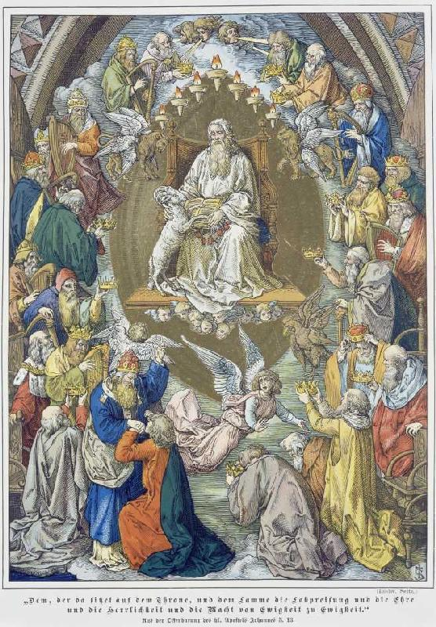
A Painting of the Throne Room of Heaven
Artist: Ludwig Seitz (1844 - 1908)
Art style: Romanticism
Title: Adoration of God with the lamb by four living being and 24 old one revelation of Johannes 5,13th end

